Slide 1
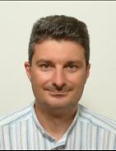
Οι σημαντικότερες δημοσιεύσεις πάνω στην αντιμετώπιση της ολιγοασθενοσπερμίας τον τελευταίο χρόνο
Φώτης Δημητριάδης

Slide 2
Δήλωση Συμφερόντων

Slide 4
Aim of The Work
To measure ROS levels in OAT patients before and after treatment with L-carnitine and tamoxifen
To compare efficacy of L-carnitine and tamoxifen on semen parameters in OAT patients
To compare the effects of L-carnitine and tamoxifen on sperm ultrastructure in OAT patients

Slide 10
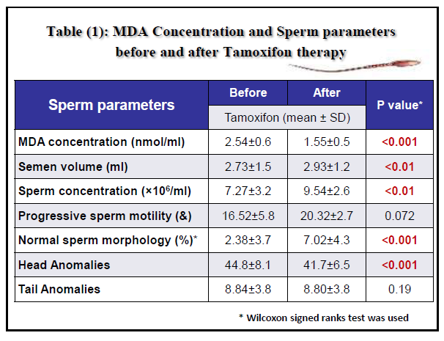

Slide 11
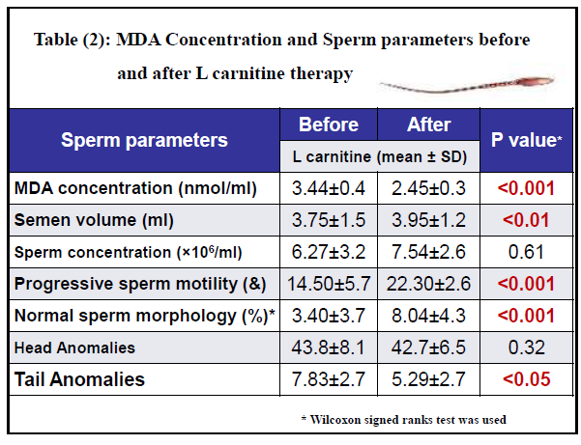

Slide 12
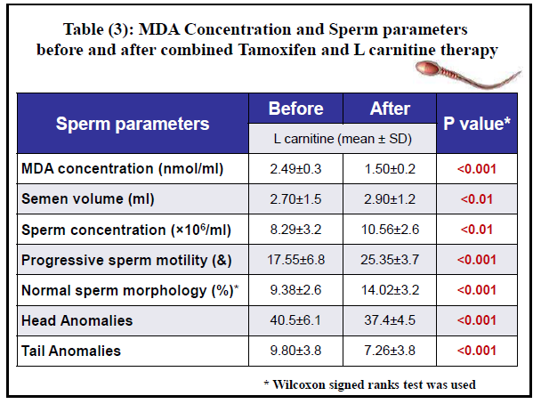

Slide 13
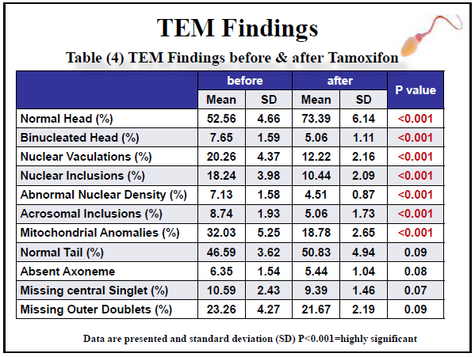

Slide 14
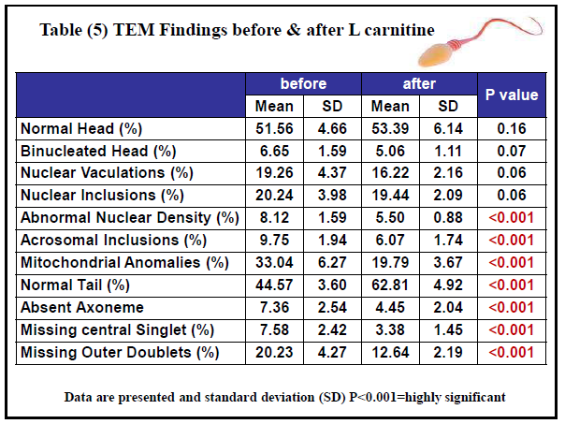

Slide 15
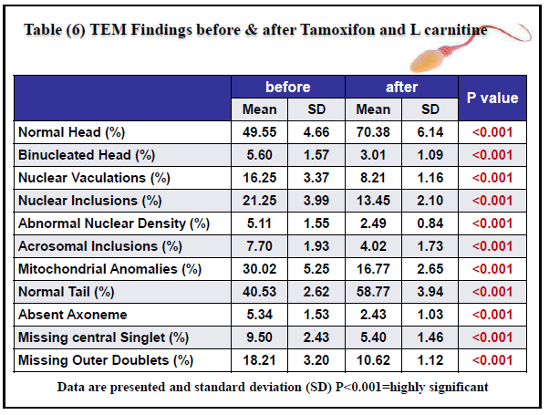

Slide 16
The Tamoxifen group showed significant improvement in sperm concentration, sperm morphology(P < 0.01)
The L-carnitine group, significant improvements in sperm motility, sperm morphology (P < 0.01)
The treatment combination group showed improvement in all semen parameters (P < 0.01)

Slide 18
Περιορισμοί
Μικρό δείγμα ασθενών
Δεν υπάρχει ομάδα ελέγχου
Δεν υπάρχει αναφορά στο ποσοστό εγκυμοσύνης

Slide 19
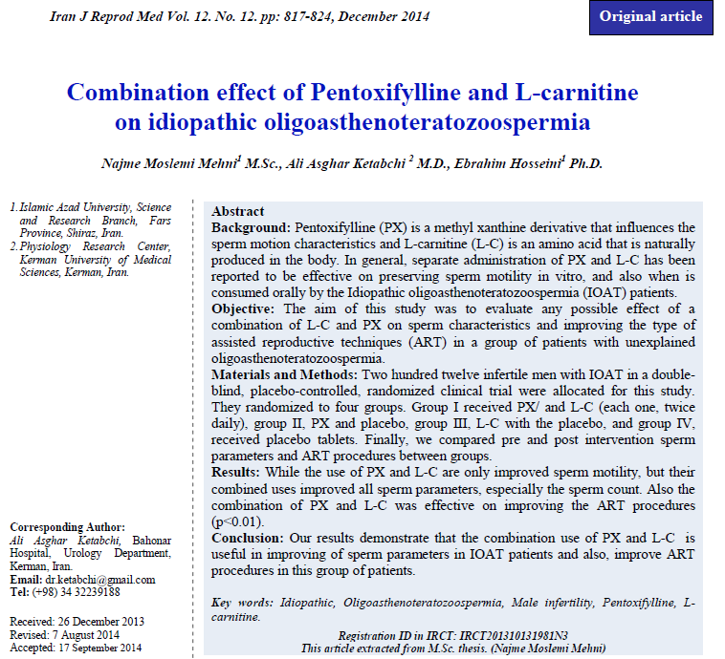

Slide 20
Aim of The Work
Τo evaluate any possible effect of a combination of L-C and PX on sperm characteristics
Το improve the type of assisted reproductive techniques in patients with unexplained OAT.

Slide 21
Study Design
double-blind, placebo-controlled, randomized clinical trial
Patients & Methods
212 pts
Group I
PX400mg
+
L-C500mg
Twice daily
Group II
PX400mg
+
placebo
Twice daily
Group III
L-C500mg
+
placebo
Twice daily
Group V
2 placebos
Twice daily

Slide 22
Patients & Methods
Medical assessment
Genital U/S
Two semen samples (before and after intervention; WHO 2010)
Evaluation of ASA
Hormonal evaluation (FSH, LH, T, E2, PRL)

Slide 23
Patients & Methods
Comparison of pre and post intervention
sperm parameters
ART procedures between groups (IUI, IVF, ICSI)

Slide 24
Results

Slide 25
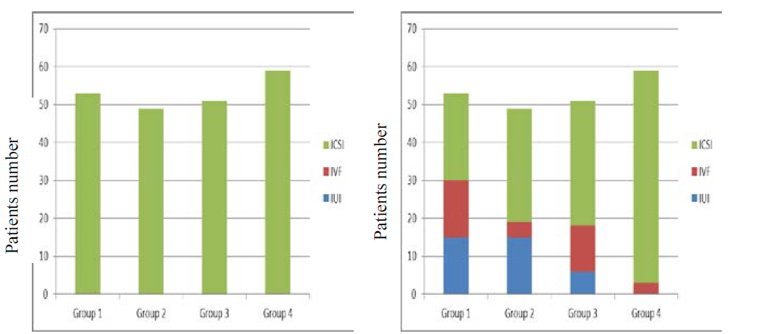
Results

Slide 26
Results
PX and L-C alone have only improved sperm motility
Their combined use improved :
All sperm parameters, especially the sperm count
ART procedure selection (p<0.01)

Slide 27
Conclusion
Combination use of PX and L-C is useful in improving of sperm parameters in IOAT patients and also, improve ART procedures

Slide 29
Aim of The Work
Τo review the literature on clinical trials in the period from year 2000 to year 2013 studying the effects of various types of antioxidant supplements in subfertile males with idiopathic OAT on :
basic and other sperm parameters
pregnancy rate.

Slide 30
Materials & Methods
PubMed searched (keywords, “male infertility” and “antioxidants”)
Reviews, controlled and randomized controlled clinical studies.
Period between 1st January 2000 and 31st December 2013
32 primary studies
They looked up for statistical significance of changes in basic sperm parameters and pregnancy rates

Slide 31
Conclusions/ Limitations
The majority of studies confirmed beneficial effect of antioxidants on at least one of the semen parameters mainly on sperm motility.
Antioxidants play an important role in protecting semen from ROS and can improve basic sperm parameters in case of idiopathic OAT
In many of these trials combinations of more antioxidants were assessed
The optimal dosages of one or more antioxidants were not defined

Slide 32
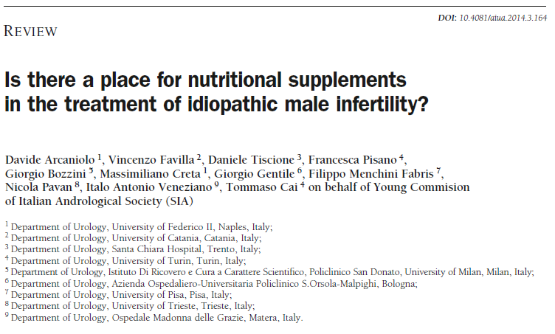

Slide 33
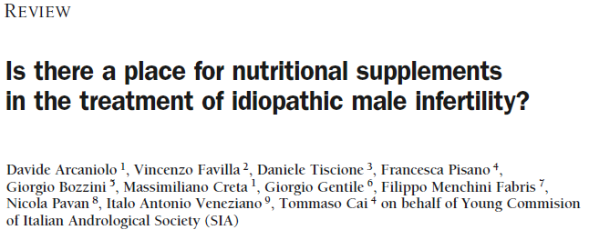
Aim of The Work
To review the effects of nutritional supplements as medical treatment for idiopathic male infertility.

Slide 34
Materials & Methods
A Pub Med and Medline review of the published studies utilizing nutritional supplements for the treatment of male infertility
Were reviewed clinical trials on:
Vitamin E, A, C
Arginine
Carnitine
N-Acetyl-Carnitine
Glutathione
Coenzyme Q10
Selenium
Zinc

Slide 35
Results and conclusions
Wide variability in selected population, dose regimen and final outcomes.
Nutritional supplements both alone and in combination seem to be able to improve semen parameters and pregnancy rate in infertile men.
This improvement, however, is not consistent and there is a wide variation in the treatment regimens used.
Well designed and adequately powered RCTs are needed

Slide 36
Περιορισμοί
Δεν αναφέρεται η στατιστική μέθοδος ανάλυσης
Δεν υπάρχουν γραφήματα ή πίνακες συσχέτισης

Slide 38
Patients
A total of 3,478 mother-child pairs were sampled
1,773 completed the outcome
69 children were born after fertility treatment
132 were born to subfertile parents conceiving spontaneously but after a time to pregnancy of more than 12 months.
1,572 children were born to parents conceiving spontaneously within 12 months
At the age of 5, the children participated in a follow-up including anthropometric measurements.

Slide 39
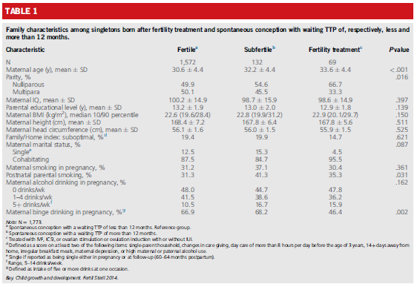

Slide 42
There were no differences in child anthropometrics at 5 years between children conceived after fertility treatment or by subfertile parents compared with that of children born to fertile parents.
However, children born after fertility treatment may show catch-up growth during childhood.

Slide 44
This prospective study with adjustment for maternal intelligence and education provides elegant and convincing evidence that
-subfertility is not associated with deficits in child cognitive function
- fertility treatments are not associated with cognitive impairment

Slide 46
OBJECTIVES:
To report the findings of two studies that examined factors predicting infertility distress in male partners within couples with an infertility diagnosis and where the couple was receiving fertility treatment.

Slide 47
DESIGN:
A cross-sectional design was implemented using a questionnaire battery.
METHODS:
Infertility related distress was examined in relation to relationship dynamics,
self-esteem,
current mental health
attitudes towards idealised masculinity.
The questionnaire battery was completed by 167 Irish men

Slide 48
RESULTS:
Regression analyses identified four variables that predicted variance in infertility distress in both studies:
'Attitude towards idealised masculinity',
'Mental health',
'Relationship satisfaction‘
'Self-esteem‘.

Slide 49
CONCLUSION:
Recommendations for fertility clinics and mental health professionals should be made in relation to managing infertility distress and supporting couples during fertility treatment.

